Slide 1
CRICKET SCORE EVALUATOR

Slide 2
agenda
ARRAY MEMBERS:
S.VARUNA
R.DHANYA
G.RUBAPRIYA
K.HARINI SHREE

Slide 3
Sachin tendulkar
ENJOY THE GAME AND CHASE YOUR DREAMS
DREAMS DO COME TRUE

Slide 4

SACHIN TENDULKAR
“DON’T STOP CHASING YOUR DREAMS,BEACAUSE DREAMS
DO COME TRUE.”

Slide 5
C PROGRAMMING
C is a general-purpose programming language created by Dennis Ritchie at the Bell Laboratories in 1972.
It is a very popular language, despite being old. The main reason for its popularity is because it is a fundamental language in the field of computer science.
C is strongly associated with UNIX, as it was developed to write the UNIX operating system.
It is one of the most popular programming language in the world

Slide 6
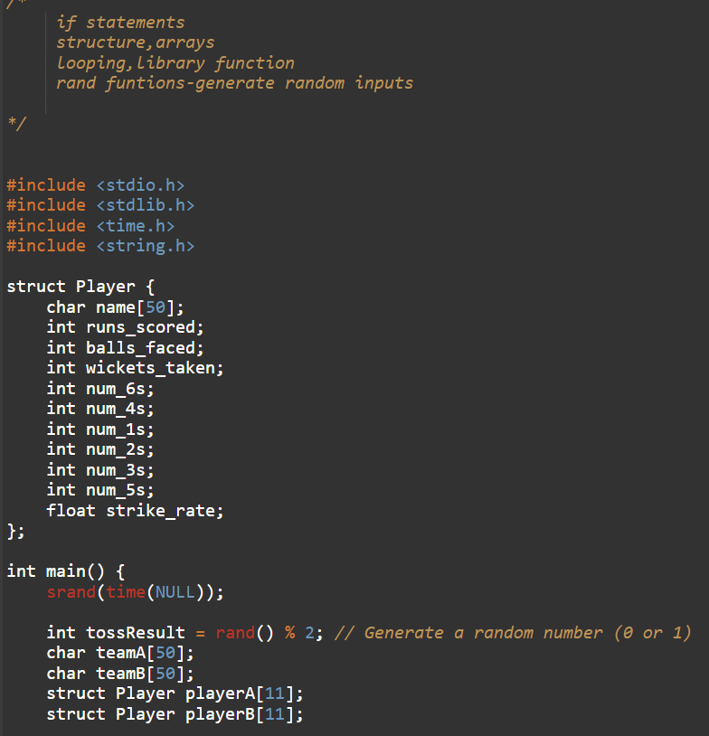
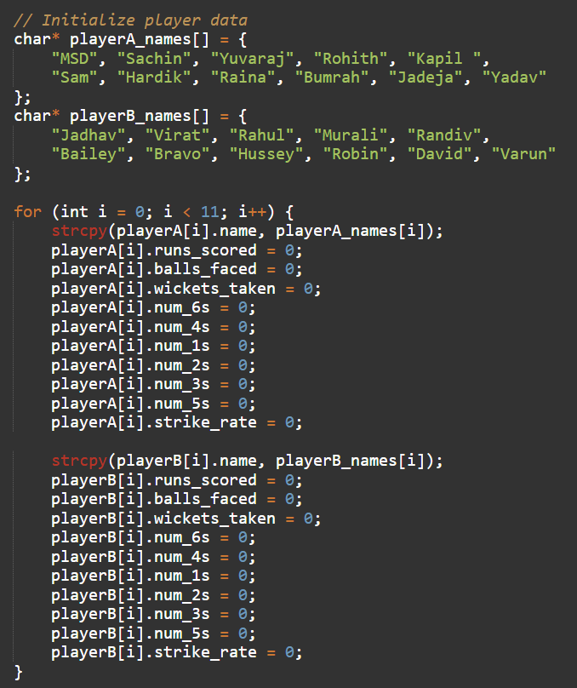
PROGRAM…

Slide 7
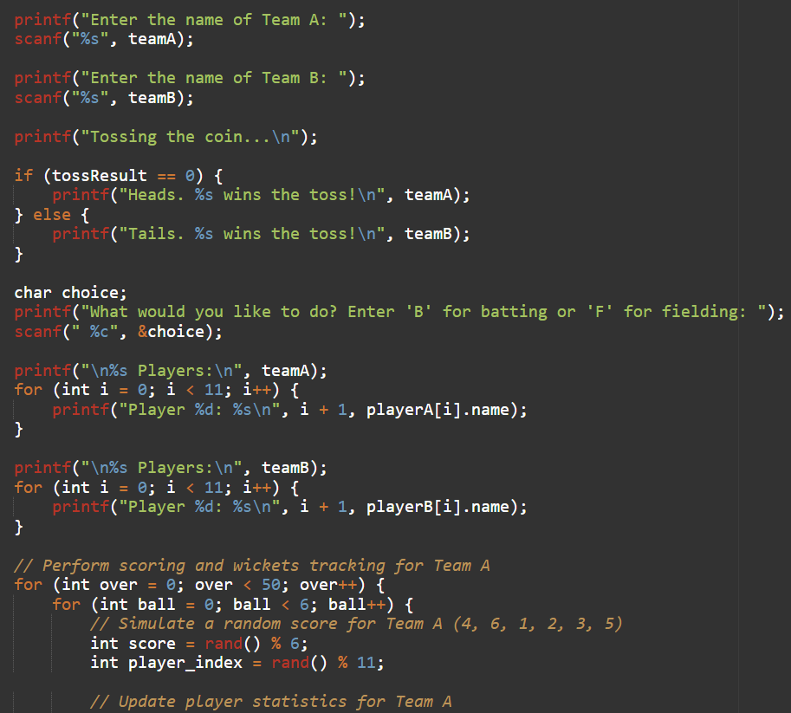
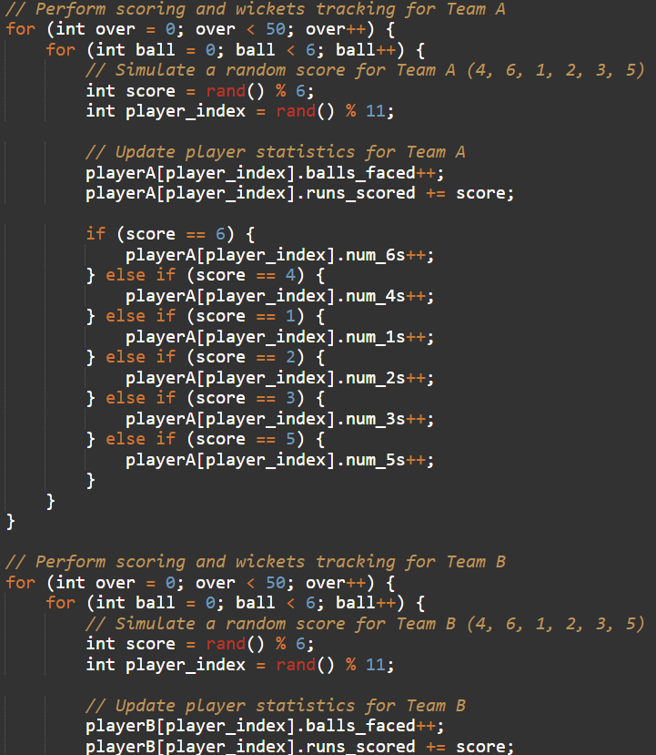

Slide 8
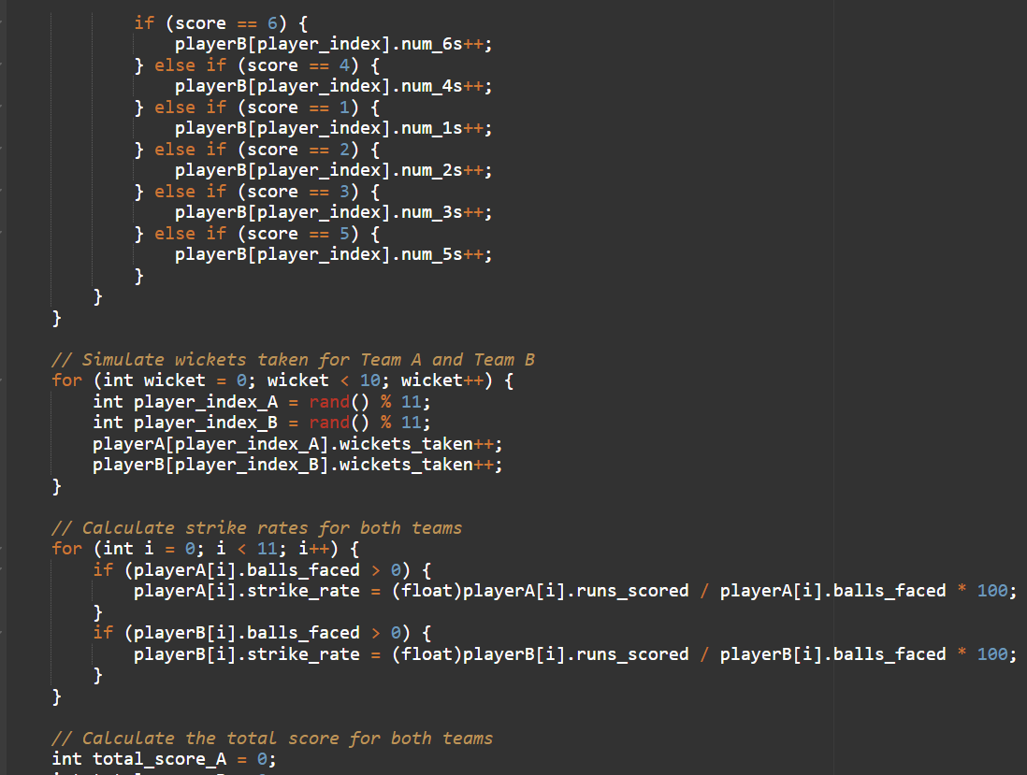
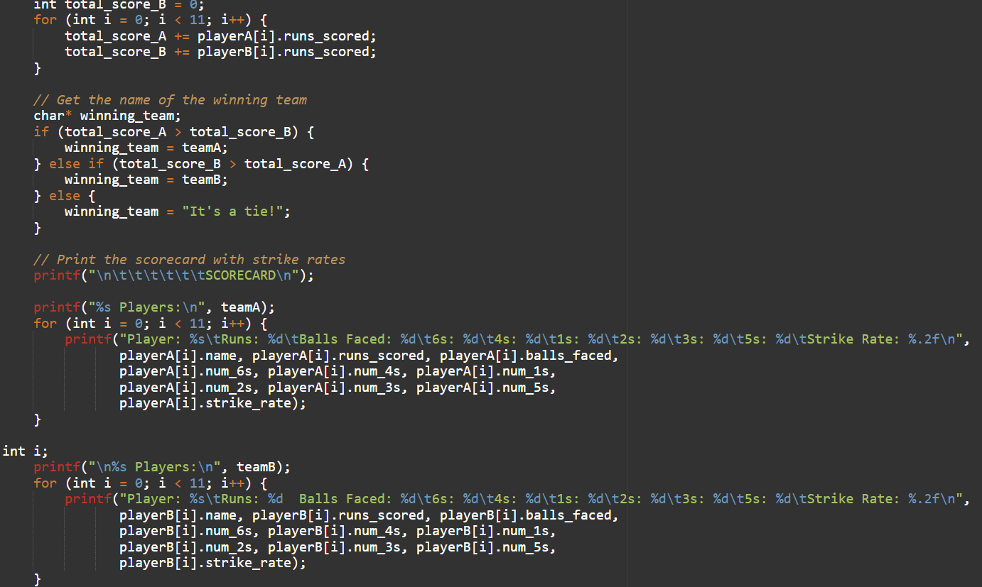

Slide 9
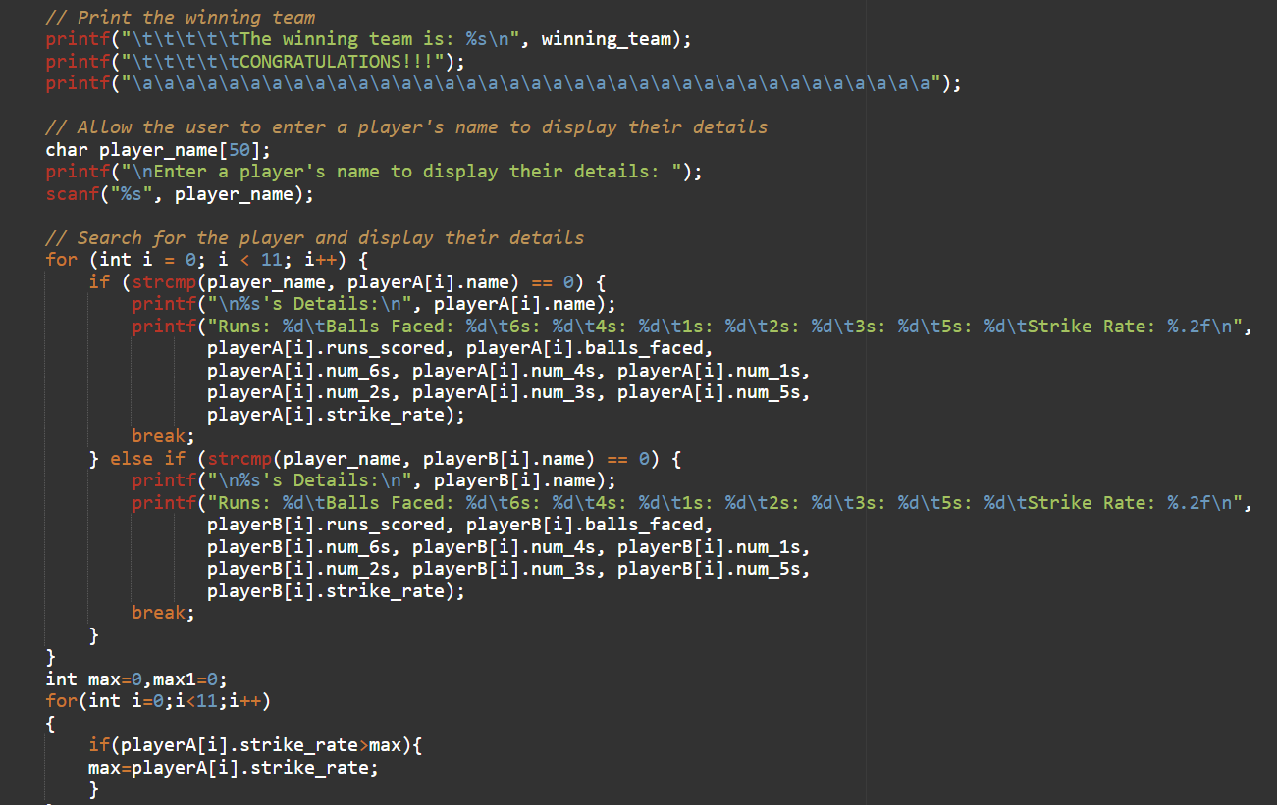
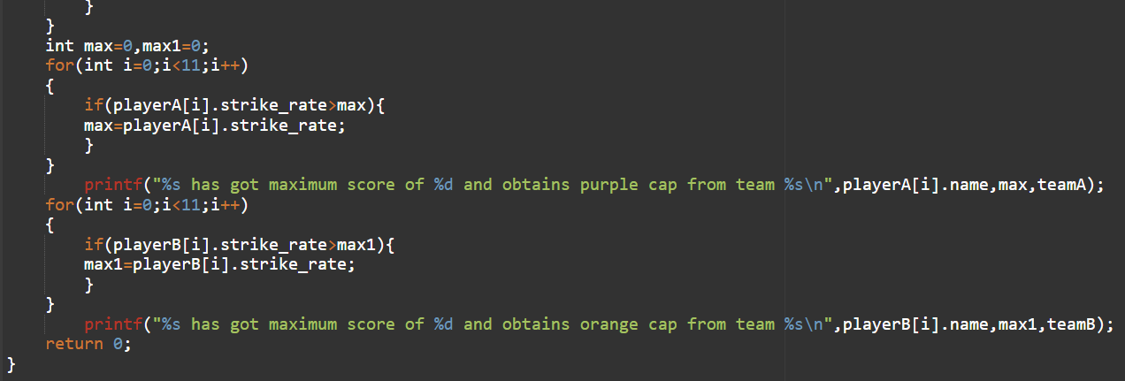

Slide 10
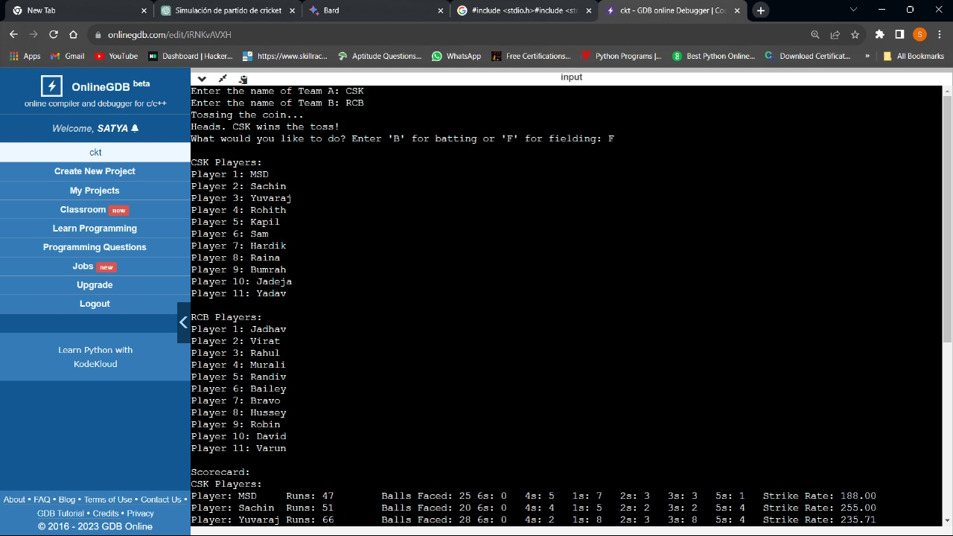
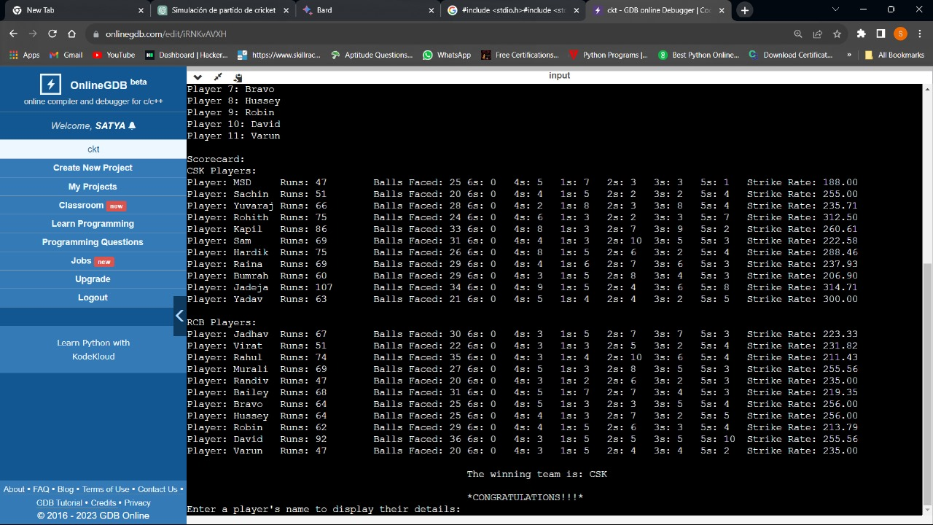
OUTPUT..

Slide 11
THANK YOU

